Slide 1
Computer Science
Tony Gaddis 5th Ed Starting Out with C++
Chapter 4
Making Decisions
Mohammad Al-Husseini

Slide 2
Relational Operators
Thus far, your programs have asked for input, done some calculation, and displayed a result
This is not an entirely useful program, its always going to perform the same operation
We can compare pieces of data to perform more complex logic

Slide 3
Relational Operators
> Greater Than < Less Than >= Greater Than or Equal To <= Less Than or Equal To == Equal To != Not Equal To
x > y Is x Greater Than y? x < y Is x Less Than y? x >= y Is x Greater Than or Equal To y? x <= y Is x Less Than or Equal To y? x == y Is x Equal To y? x != y Is x Not Equal To y?

Slide 4
Relational Operators
The result of a relational expression is boolean (true or false)
Recall that true and false are keywords
false represents the integer 0
true represents any non-zero integer, usually 1
They are technically constants and true = 1
But the logic of true can be any non-zero integer
Warning: Don’t confuse == and =
= is the assignment operator
== is the equality operator

Slide 5
Relational Operators
Note: Relational operators have a higher precedence than the assignment operator
Assume x = 10, y = 7, and z, a, and b are either ints or bools
z = x < y; z = 0 because x < y is false
a = x >= y; a = 1
b = y != x; b = 1
cout << (x > y); 1
cout << x <= y; 0

Slide 6
Checkpoint
Assume x = 5, y = 6, and z = 8. True or False
x == 5
7 <= (x + 2)
z < 4
(2 + x) != y
z != 4
x >= 9
x <= (y * 2)

Slide 7
Checkpoint
True or False
x <= y is the same as y > x
x != y is the same as y >= x
x >= y is the same as y <= x
Yes or No
If x > y and x < z, is y < z?
If x >= y and z == x, is z == y?
If x != y and x != z, is z != y?

Slide 8
Checkpoint
What will the following program display? #include <iostream> using namespace std; int main() { int a = 0, b = 2, x = 4, y = 0; cout << (a == b) << endl; cout << (a != y) << endl; cout << (b <= x) << endl; cout << (y > a) << endl; return 0; }

Slide 9
The if Statement
Previous programs have followed a sequence structure, taking one step after another
cout << “Enter a length: “; cin >> length; cout << “Enter a width: “; cin >> width; area = length * width; cout << “The area is: “ << area;
But most programs perform more complex operations that require more than one sequential path
What if we wanted the area of other shapes?

Slide 10
The if Statement
A simple example is a letter grade calculator
totalScore >= 90
True
Display “Congratulations! That’s an A!”
False

Slide 11
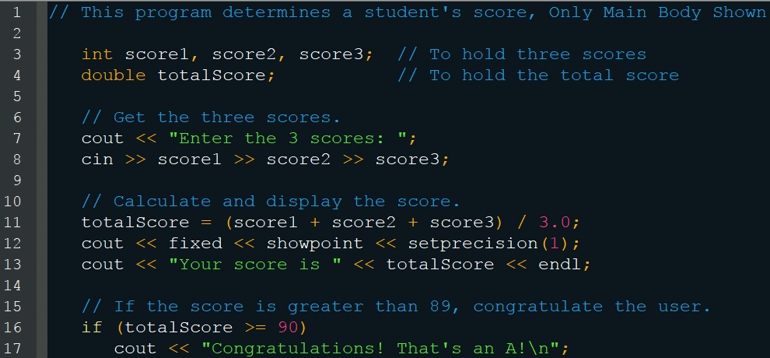
The if Statement
if (expression) statement;

Slide 12
if Notes
Do not put a semicolon after the if statement
bool b = false; if(b); cout << “b is true”;
This skips the if statement and the cout is always executed
The statements in the if statement should be indented for readability
bool meeting = true; if(meeting) if(meeting) cout << “Hello”; cout << “Hello” cout << “Goodbye.” cout << “Goodbye.”

Slide 13
if Notes
Do not mix up the assignment and equality operators
int a = 2, b = 3; if(a = b) cout << “A is the same as B”;
Remember that the assignment operator returns its value, so a will be set equal to b and its value returned
That value is non-zero so it will equate to true
And this will display that A is the same as B

Slide 14
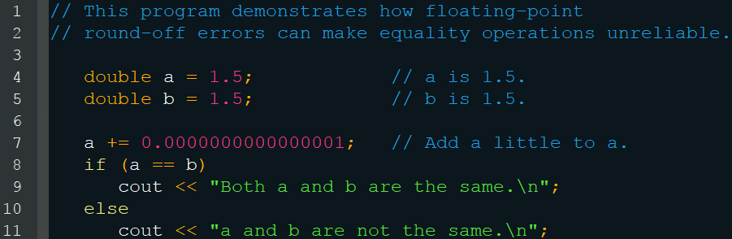
if Notes
Avoid the equality operator when comparing floating point numbers, use >= or <=
Will display that they are the same
This is behavior is caused by rounding errors

Slide 15
Expanding the if Statement
You can have multiple statements inside the if
To do so, you must use braces
if(expression { statement; statement; … }
You don’t need the braces with a single statement, but it is still good to include them for clarity

Slide 16
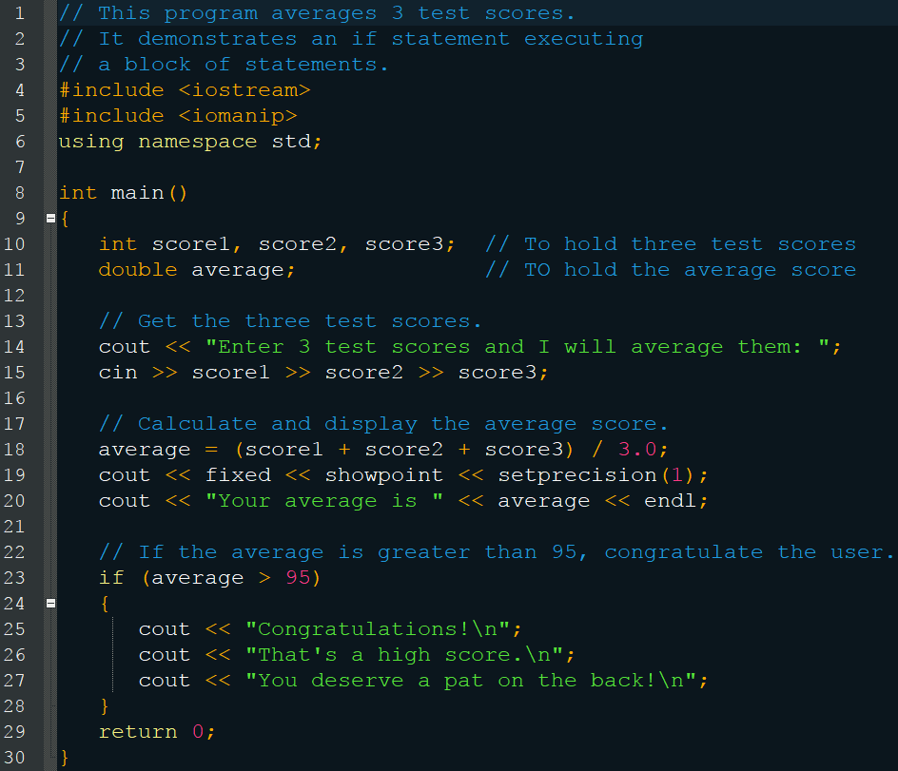
Expanding the if Statement

Slide 17
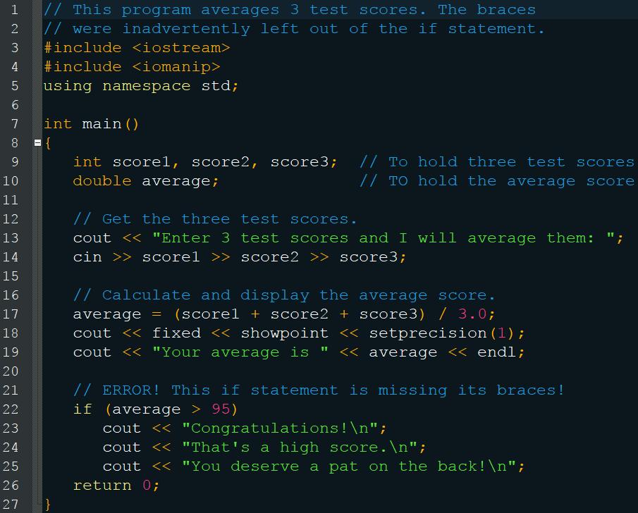
Don’t Forget the Braces

Slide 18
Flag Variables
Typically a bool variable that signals when a condition is met
bool highScore = false; if (average > 95) highScore = true; if(highscore) cout << “Congratulations! That’s a high score!”;
Can also be integer
bool highScore = 0; // 0 representing false
You must initialize these variables

Slide 19
Checkpoint
True or False, These are equivalent if(sales > 10000) commissionRate = 0.15; if(sales > 10000) commissionRate = 0.15;
True or False, These are equivalent if(calls == 20) rate *= 0.5; if(calls = 20) rate *= 0.5;

Slide 20
Checkpoint
Each contains a logic error Assume the variables exist
if(hours > 40); cout << hours << “ hours qualifies for over-time.”;
balance = 1000; if(interestRate = .07) cout << “This account is earning the maximum rate.”;
if(interestRate >.07) cout << “This account earns a $10 bonus.”; balance += 10.0;

Slide 21
Checkpoint
Write an if statement that assigns 0 to x if y is equal to 20
Write an if statement that multiples payRate by 1.5 if hours is greater than 40
Write an if statement that assigns .20 to comission if sales is greater than or equal to 10000.00
Write an if statement that sets the variable fees to 50 if the variable max is set to true

Slide 22
The if/else Statement
Executes the first block if true, else it executes the second block
if ( expression ) statement or block else statement or block
Useful for many things, especially avoiding division by zero cout << “Enter two numbers: “ cin >> a >> b; if(b != 0) cout << a / b;

Slide 23
The if/else Statement
Determine if a number is even or odd
number % 2 == 0
False
True
Indicate that the number is odd.
Indicate that the number is even.

Slide 24
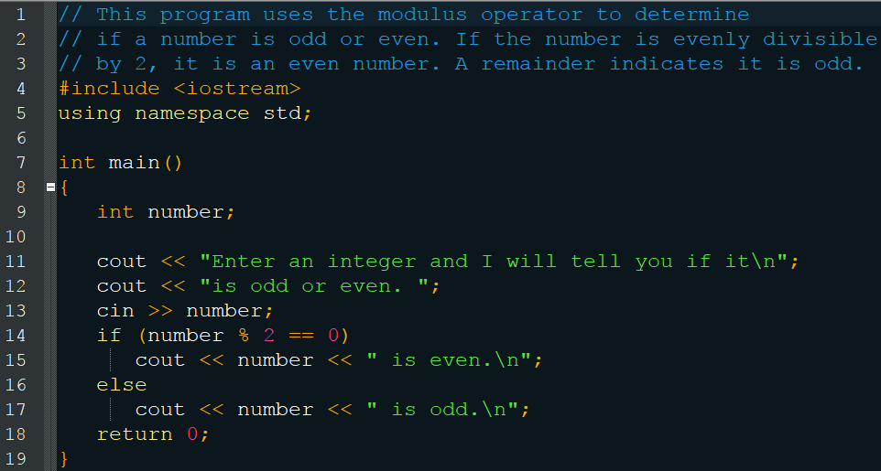
The if/else Statement

Slide 25
Checkpoint
True of False, These are equivalent
if(x > y) cout << “x is the greater”; else cout << “x is not the greater.”;
if(y <= x) cout << “x is not the greater.”; else cout << “x is the greater.”;

Slide 26
Checkpoint
Write an if/else statement that assigns 1 to x if y is equal to 100. Otherwise it should assign 0 to x
Write an if/else statement that assigns 0.10 to commission unless sales is greater than or equal to 50000.00, in which case it assigns 0.20 to commission
Write an if/else statement that assigns true to the variable even if n % 2 is true. Otherwise it should assign false to even.

Slide 27
The if/else if Statement
Starts at the first block, executing if true Otherwise continues down each block until one is true (can be multiple else if blocks) Otherwise executes the else block Only executes a single block (the first true)
if ( expression ) statement or block else if ( expression ) statement or block else statement or block

Slide 28
The if/ese if Statement
Determine letter grade
testScore < 60
false
testScore < 70
true
false
grade = ‘F’
testScore < 80
true
false
grade = ‘D’
testScore < 90
true
false
grade = ‘C’
false
testScore <= 100
true
grade = ‘B’
true
grade = ‘A’

Slide 29
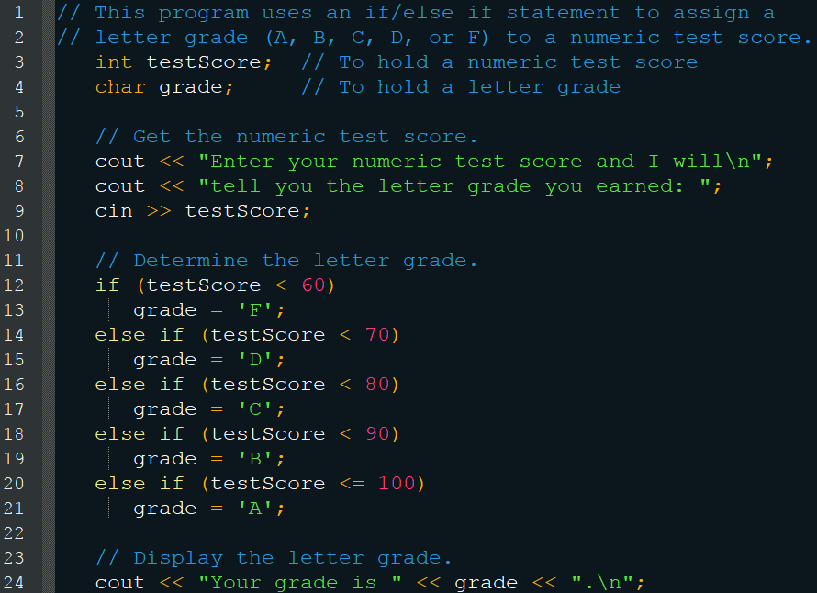
The if/else if Statement

Slide 30
Using a Trailing else
But what happens when the user enters a value greater than 100?
There is nothing to catch that event, so we’ve created a crack through which the program can fall
grade will never been initialized and so the code will throw an error when it attempts to access that value
Include an else at the end to catch all other possible values and prevent such things

Slide 31
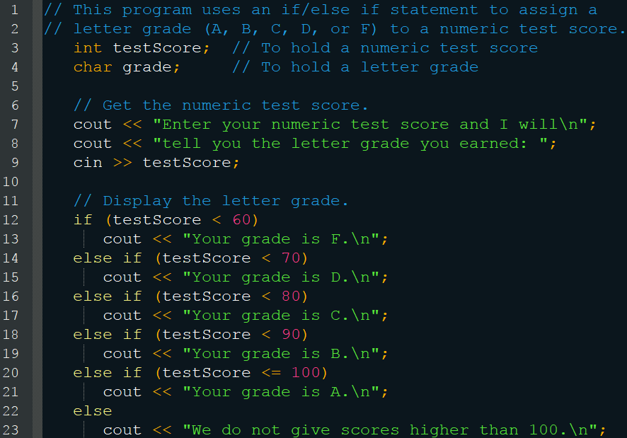
Using a Trailing else

Slide 32
Multiple if vs if/else if
You can use multiple if statements in conjunction to achieve a similar effect
But keep in mind the advantage of if/else if is that it stops executing after the first true
Multiple if statements could execute multiple times

Slide 33
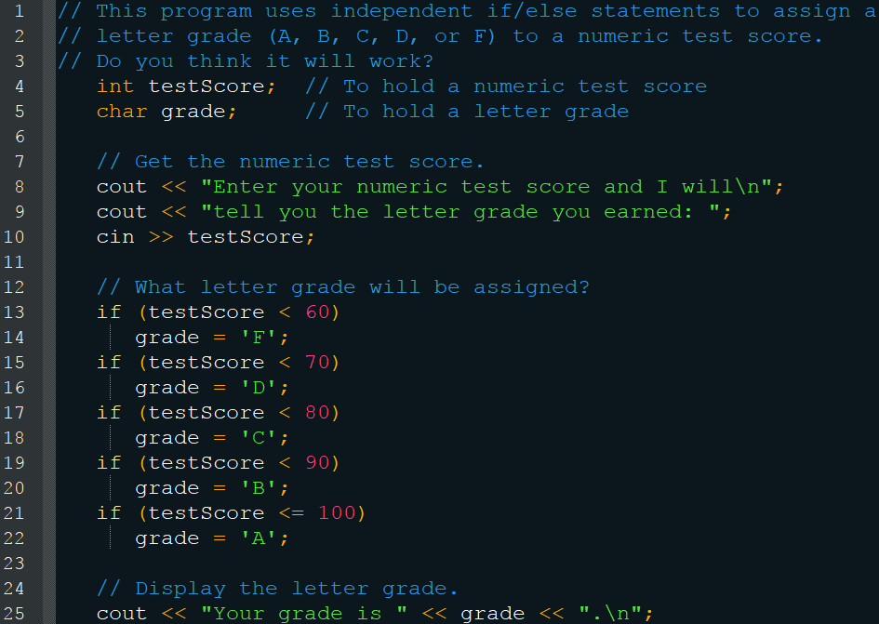
Multiple if vs if/else if

Slide 34
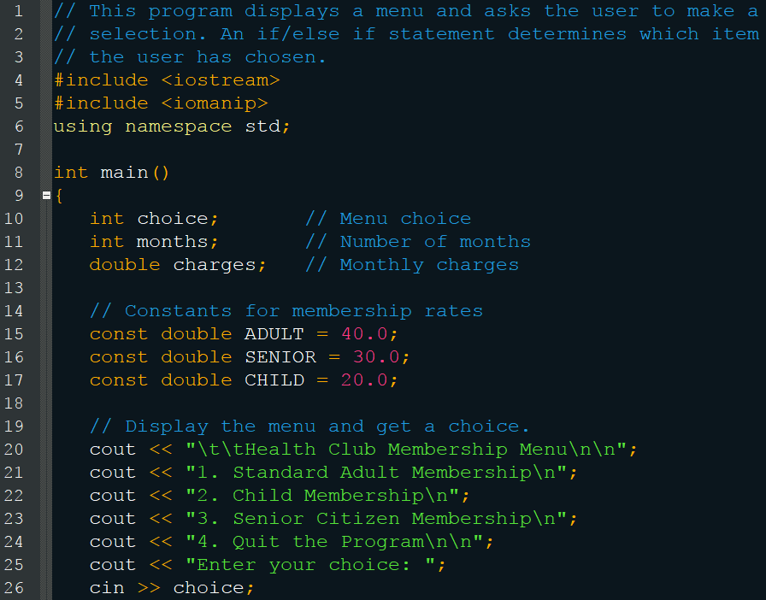
Menus

Slide 35
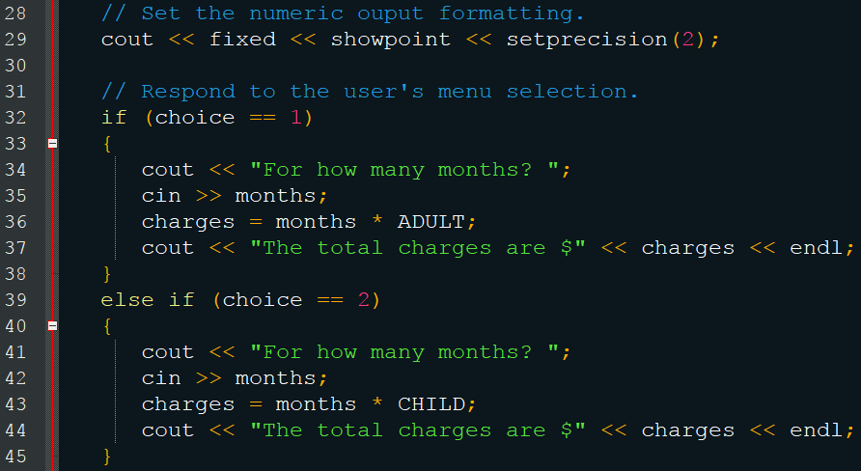
Menus

Slide 36
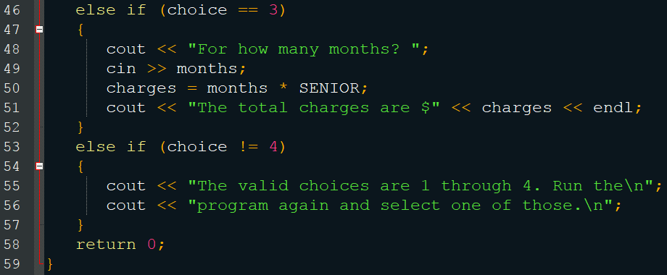
Menus

Slide 37
Nested if Statements
You can put if statements in the block of other if statements
This allows for very meaningful and deep logic
If it is raining outside and it is windy take a jacket
If it is raining outside and it is calm take a umbrella

Slide 38
Nested if Statements
employed == ‘Y’
employed == ‘Y’
false
true
Display “You must be employed to qualify.”
recentGrad == ‘Y’
false
true
Display “You must have graduated from college in the past two years to qualify.
Display “You qualify for the special interest rate.”

Slide 39
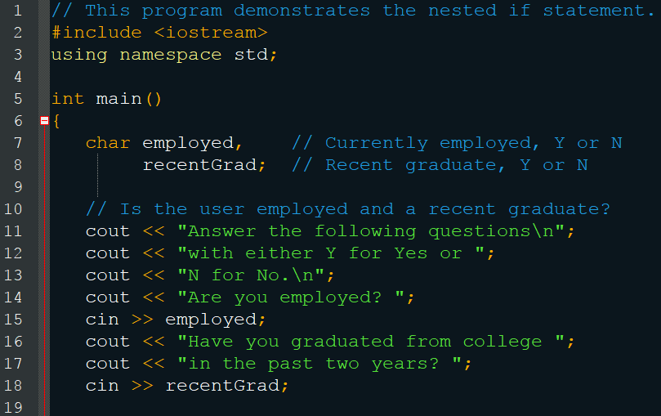
Nested if Statements

Slide 40
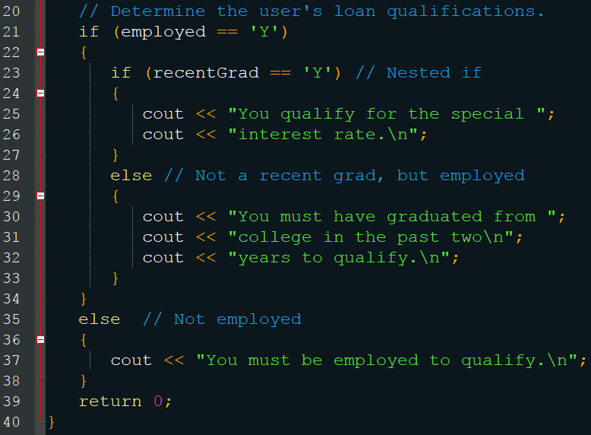
Nested if Statements

Slide 41
Checkpoint
int numBooks, numCoupons; cout << “How many books are being purchased? “; cin >> numBooks; if (numBooks < 1) numCoupons = 0; else if (numBooks < 3) numCoupons = 1; else if (numBooks <5) numCoupons = 2; else numCoupons = 3; cout << “The number of coupons is “ numCoupons;
User Enters | Coupons
1 | ?
2
3
4
5
10

Slide 42
Checkpoint
Write nested if statements that perform the following test: If amount1 is greater than 10 and amount2 is less than 100, display the greater of the two.
What is the difference between multiple if statements, if/else if statements, and nested if statements?

Slide 43
Logical Operators
Generally connect two or more relational expressions to further enhance the logic
AND
OR
NOT

Slide 44
Logical Operators
AND
&&
Both expressions must be true for the result to be true
Short circuit evaluation – If the left expression is false, then it doesn’t waste CPU time checking the right expression (result is false)
Left | Right | Result
0 | 0 | 0
0 | 1 | 0
1 | 0 | 0
1 | 1 | 1

Slide 45
Logical Operators
OR
||
Either expression (or both) must be true for the result to be true
Short circuit evaluation – If the left expression is true, then it doesn’t waste CPU time checking the right expression (result is true)
Left | Right | Result
0 | 0 | 0
0 | 1 | 1
1 | 0 | 1
1 | 1 | 1

Slide 46
Logical Operators
NOT
!
Reverses the value of the expression (makes false true or true false)
Unary
Expression | Result
0 | 1
1 | 0

Slide 47
Logical Operators
Precedence
!
&&
||
Note: AND and OR have lower precedence than the relational operators
Note: But NOT has a higher precedence
!(x > 2) // if x is greater than 2 return false
!x > 2 // is the logical negation of x greater than 2?
Suppose x = 5. x is non-zero, so negating it makes it zero zero is not greater than 2, so the result is false

Slide 48
Logical Operators
Examples:
if (employed == ‘Y’ && recentGrad == ‘Y’) cout << “You qualify for the special interest rate”;
if (income >= 35000 || years > 5) cout << “You qualify for the loan”;
if (!(income >= 35000 || years > 5)) cout << “You must earn at least $35,000 or ”; cout << “have been employed at least 5 years.”;

Slide 49
Checking Numeric Ranges
Logical operators allow us to verify is a number is inside or outside of a range
Use AND to check if it is inside a range
if (x >= 20 && x <= 40) cout << “x is 20 – 40)”;
Use OR to check if it is outside a range
if (x < 20 || x > 40) cout << “x is not 20 – 40”;
Beware
if (x < 20 && x > 40)
if (x < 20 | x > 40) if (x >=20 & x <= 40)
if (x < 20 || > 40) if (20 < x < 40)

Slide 50
Checkpoint
What is the disadvantage of using the && logical operator instead of the nested if?
Expression | Result
true && false | ?
true && true
false && true
false && false
true || false
true || true
false || true
false || false
!true
!false

Slide 51
Checkpoint
Assume a = 2, b = 4, and c = 6. True or False
a == 4 || b > 2
6 <= c && a > 3
1 != b && c != 3
a >= -1 || a <= b
!(a > 2)

Slide 52
Checkpoint
Write an if statement that prints the message “The number is valid” if the variable speed is within the range 0 through 200.
Write an if statement that prints the message “The number is not valid” if the variable speed is outside the range 0 through 200.

Slide 53
Validating User Input
Never assume that the user enters the correct information, C++ does
If you fail to do so, it could cause your program to crash and potentially lose data (if you are writing files)
Use if statements in conjunction with relational and logical expressions

Slide 54
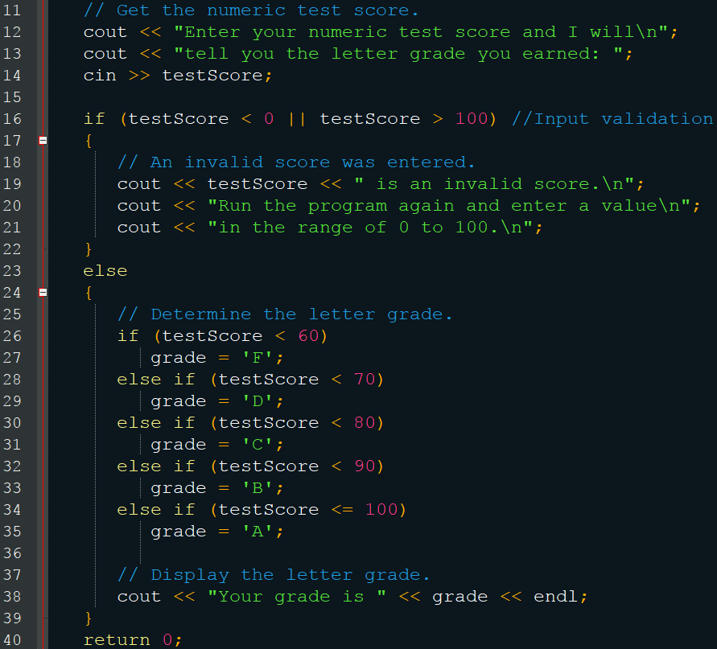
Validating User Input

Slide 55
Variable Scope
A variable’s scope is the block it is defined in, between a set of { }
This includes if statements
It is generally best to define variables at the start of the block, but is sometimes better to define them (before) where they are relevant
As long as two variables are in different scopes, they can have the same name (though you should generally avoid this)
Statements will use the variable in the same block as them

Slide 56
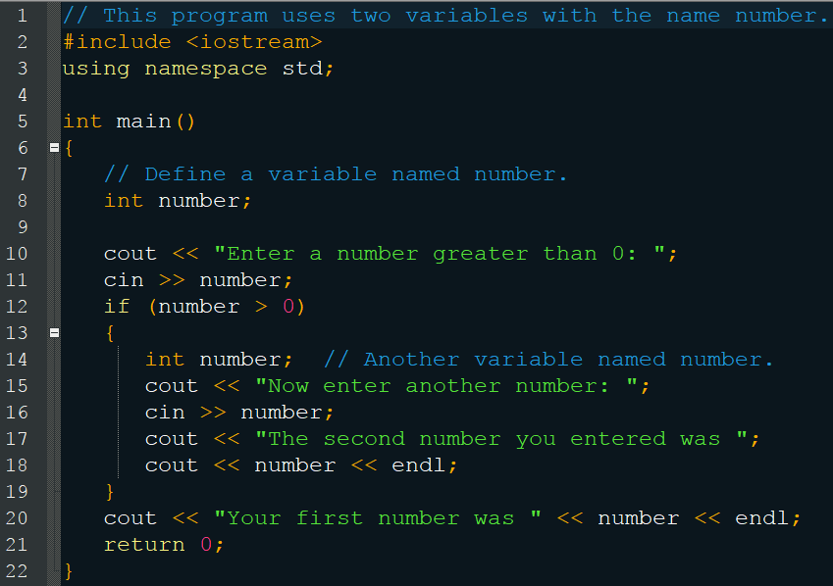
Variable Scope

Slide 57
Checkpoint
What is wrong with this code: int first, second, result; cout << “Enter a negative integer: “; cin >> first; cout << “Enter a positive integer: “; cin >> second; if(first >= 0 || second < 0) cout << “Good job!”;

Slide 58
Checkpoint
What will the following display: int test1 = 40, test2 = 30; int sum = test1 + test2; if(sum > 50) { test1 += 10; test2 += 10; int sum = test1 + test2; } cout << test1 << “, “ << test2 << “, “ << sum;

Slide 59
Comparing Strings
You cannot use relational operators to compare c-strings
if(firstString == secondString)
This compares the memory addresses, which are (almost) always different
You must use a function
strcmp(string1, string)
Requires #include <cstring>
Returns 0 if the strings are the same
Returns <0 if string1 < string2
Returns >0 if string1 > string2

Slide 60
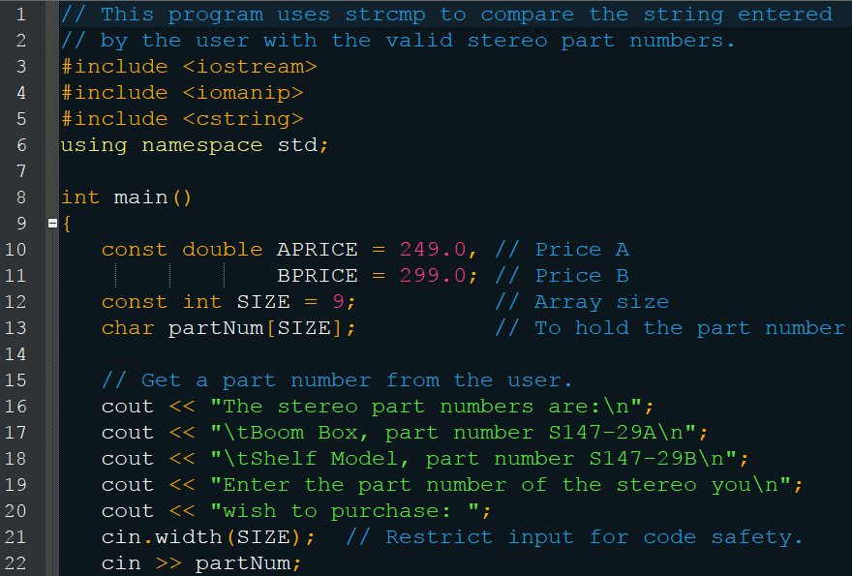
Comparing Strings

Slide 61
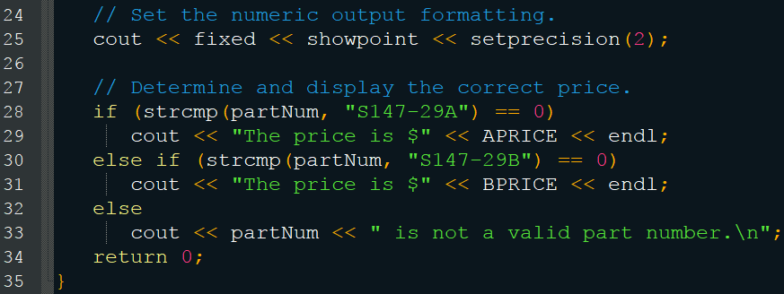
Comparing Strings
Think of strcmp as reverse logic
if (!strcmp(partNum, “S147-29A”)) else if (!strcmp(partNum, “S147-29B”))

Slide 62
Sorting Strings
Utilize the negative or positive return from strcmp to determine the order
If string1 > string2, the result is positive
This means string1’s ASCII representation is a larger number, which means it appears later in the alphabet
Therefore, this is comes after string2 alphabetically
Remember the order
Numbers
Uppercase
Lowercase

Slide 63
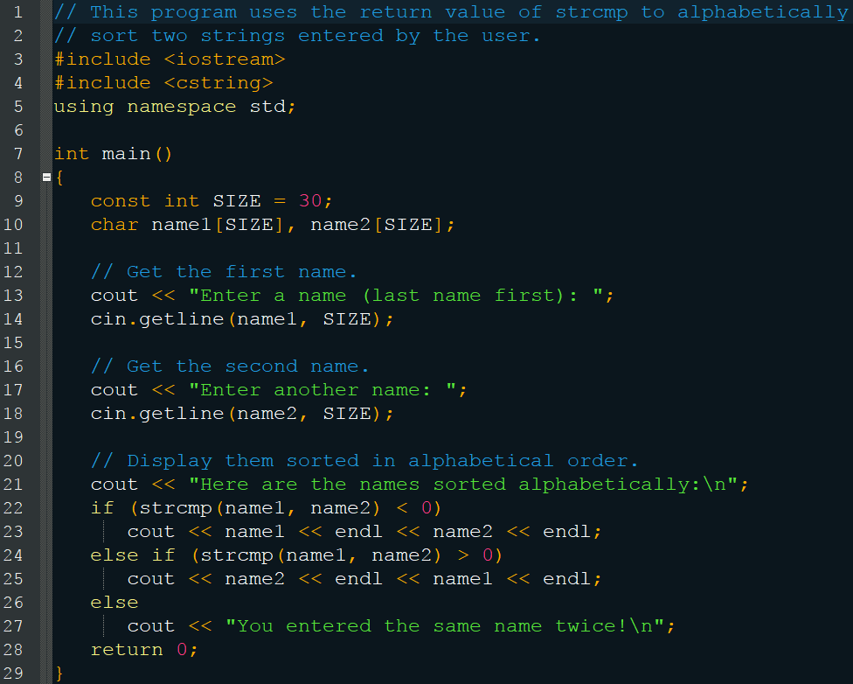
Sorting Strings

Slide 64
Checkpoint
Indicate 0, positive, or negative
strcmp(“ABC”, “abc”);
strcmp(“Jill”, “Jim”);
strcmp(“123”, “ABC”);
strcmp(“Sammy”, “Sally”);
Would you use strcmp to compare characters?

Slide 65
The Conditional Operator
The only ternary operator, which is a shorthand for the if/else statement
expression ? expression : expression;
test ? true : false;
x < 0 ? y = 10 : z = 20;
If x < 0, then y = 10, else z = 20
It returns its value
a = x > 100 ? 0 : 1; if (x > 100) a = 0;
If x > 100, then a = 0, else a = 1 else a = 1;

Slide 66
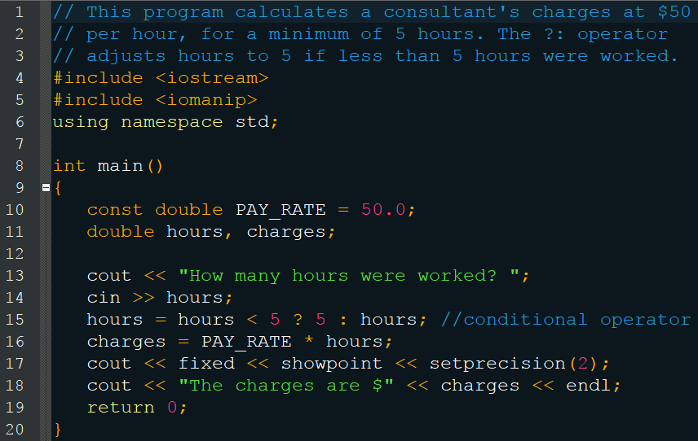
The Conditional Operator

Slide 67
The Conditional Operator
Be warned, it had a lower precedence than the stream operators
cout << “Your grade is: “ << (score < 60 ? “Fail.” : “Pass”);
Hence it requires the parenthesis

Slide 68
Checkpoint
Rewrite the if/else statements as a conditional expressions
if (hours > 40) wages *= 1.5; else wages *= 1;
if (result >= 0) cout << “The result is positive\n”; else cout << “The result is negative.\n”;

Slide 69
Checkpoint
Rewrite the conditional expresses as if/else statements
total += count == 1 ? sales : count * sales;
cout << (((num % 2) == 0) ? “Even” : “Odd”);

Slide 70
The switch Statement
Like an if / else if / else statement, but you are comparing a single integer/character variable with multiple values
Excellent for menus
switch (IntegerExpression) { case ConstantExpression: // One or more statements … default: // One or more statements }

Slide 71
The switch Statement
Your switch must be an integer or character variable (generally)
Your cases must be a constant and cannot be an expression or variable
You may have many cases but they must all be unique
The default statement is optional
Use break; between your cases to prevent fall-through
break is optional for the default statement

Slide 72
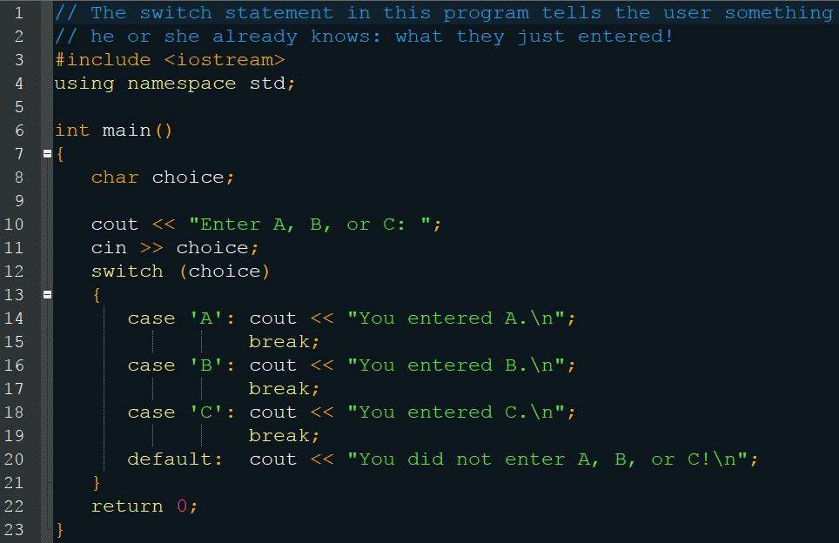
The switch Statement

Slide 73
The switch Statement
If you do not use break; then it will continue executing lines
This is a confusing error
But sometimes, this is also a behavior you want

Slide 74
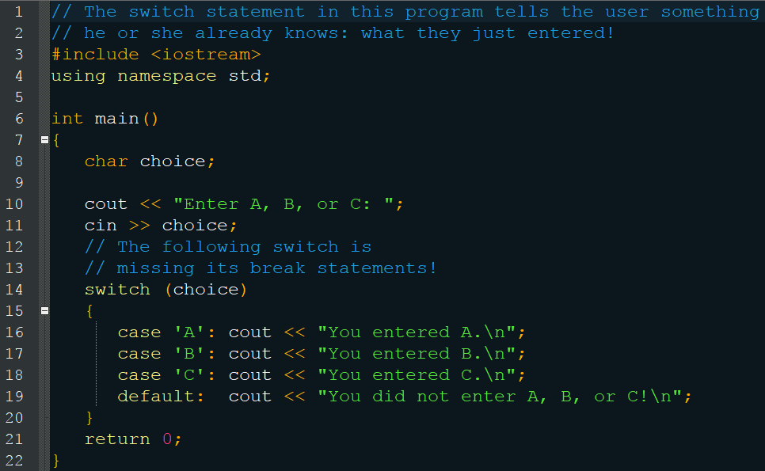
Accidental Fallthrough

Slide 75
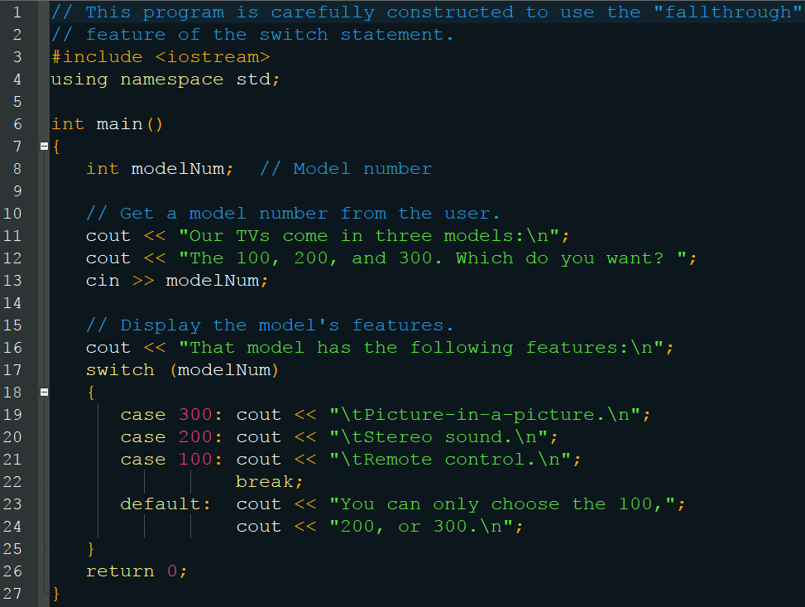
Intentional Fallthrough

Slide 76
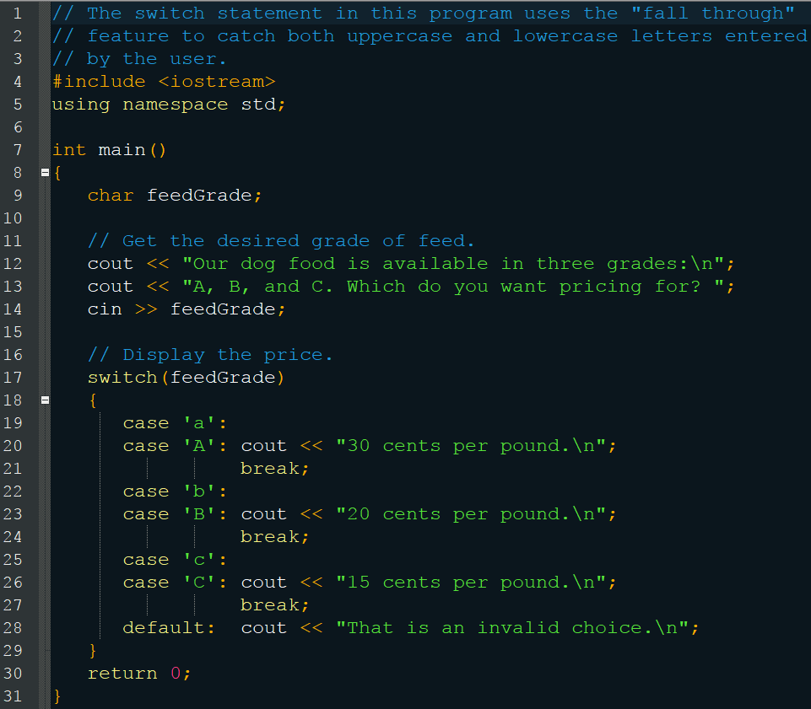
Intentional Fallthrough

Slide 77
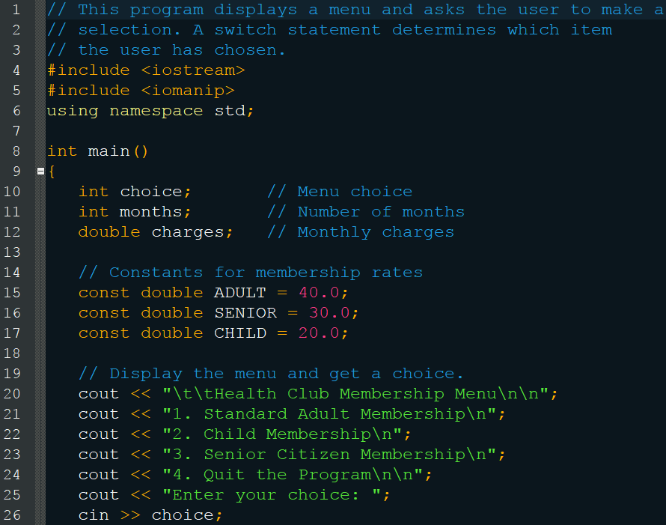
Menu switch

Slide 78
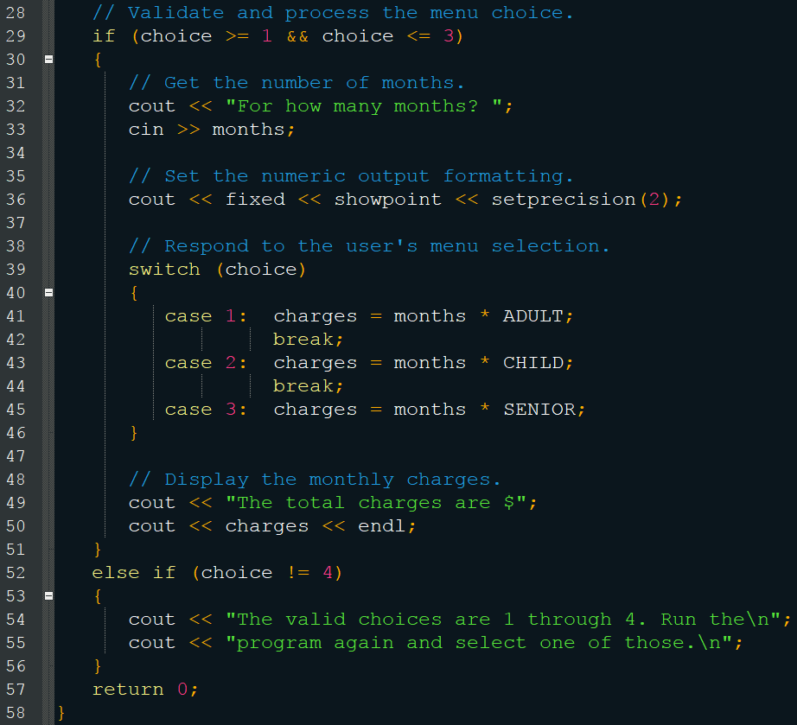
Menu switch

Slide 79
Checkpoint
Why can’t you convert this isn’t a switch? if (temp == 100) x = 0; else if (population > 1000) x = 1; else if (rate < .1) x = -1;

Slide 80
Checkpoint
What is wrong with this switch statement? switch (temp) { case temp < 0 : cout << “Temp is negative.”; break; case temp == 0 : cout << “Temp is zero.”; break; case temp > 0 : cout << “Temp is positive.”; break; }

Slide 81
Testing for File Open Errors
Recall that input files are not created when opened
This will cause an error if they do not exist
ifstream inputFile; inputFile.open(“info.txt”);
Now that you know if statements, we can avoid this
When the file is opened, its variable is set to either true (if it was opened successfully) or false (if it was not)

Slide 82
Testing for File Open Errors
Use this true/false attribute to test the opening
ifstream inputFile; inputFile.open(“info.txt”); if(!inputFile) { cout << “Error opening file.”; }
You can also use a member function
ifstream inputFile; inputFile.open(“info.txt”); if(inputFile.fail()) cout << “Error opening file.”;

Slide 83
Testing for File Open Errors
You can also check that output files opened
Even though they are created when opened, there are still circumstances that could prevent them from being opened
ofstream outputFile; outputFile.open(“customer.txt”); if(outputFile.fail()) cout << “The customer.txt file could not be opened. Perhaps the disk is full or you do not have sufficent privileges. Contact your system manager for assistance.”

